Slide 1
The suppression of records in the Network Zone and Member Institution and how it Influences Primo Discovery
Yoel Kortick
Senior Librarian

Slide 2
The environment
What happens in Alma and Primo when nothing is suppressed?
What happens in Alma and Primo after we suppress the record only in the network zone?
What happens in Alma and Primo after we suppress the record in the member institution and network zone?
What happens in Alma and Primo after we suppress the record only in the member institution?
Conclusions

Slide 3
The environment

Slide 4
The environment
The network zone consortial environment in Primo VE
Network Zone
Member
Alma University
Member
Open University
Member
University of Knowledge

Slide 5
What happens in Alma and Primo when nothing is suppressed?

Slide 6
What happens in Alma and Primo when nothing is suppressed?
The record
In the network zone title “On women's films : across worlds and generations” is MMSID 99327611100191

Slide 7
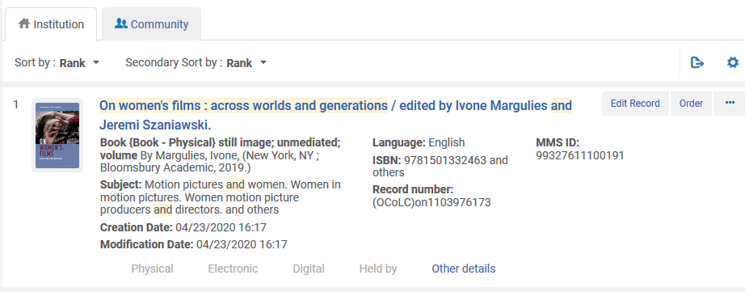
What happens in Alma and Primo when nothing is suppressed?
Here is the record now when searching the network zone (we have not yet linked from institution or suppressed)
The record in the network zone is currently not held by any member

Slide 8
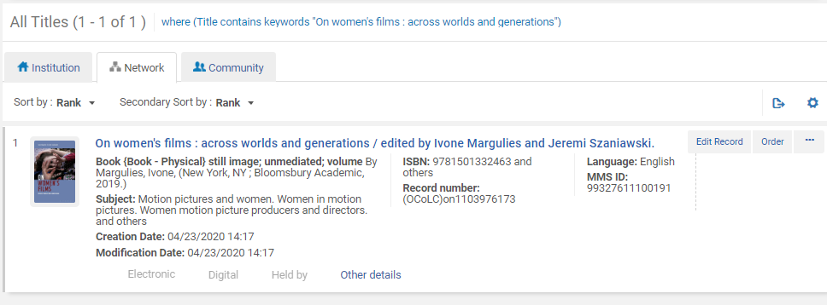
What happens in Alma and Primo when nothing is suppressed?
Here is the record when searching Alma University network tab
In the member institution the record was found via the network tab. Now a staff user will edit the record and add inventory (a holdings record and item.

Slide 9
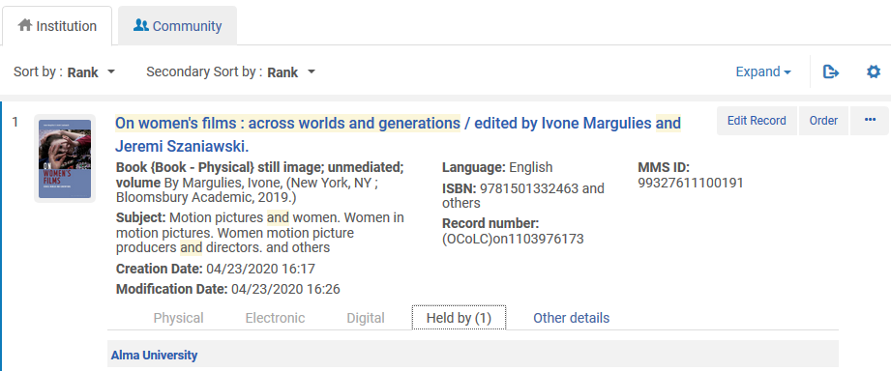
What happens in Alma and Primo when nothing is suppressed?
Now we again search the network zone
Now we do see that it is held by an institution

Slide 10
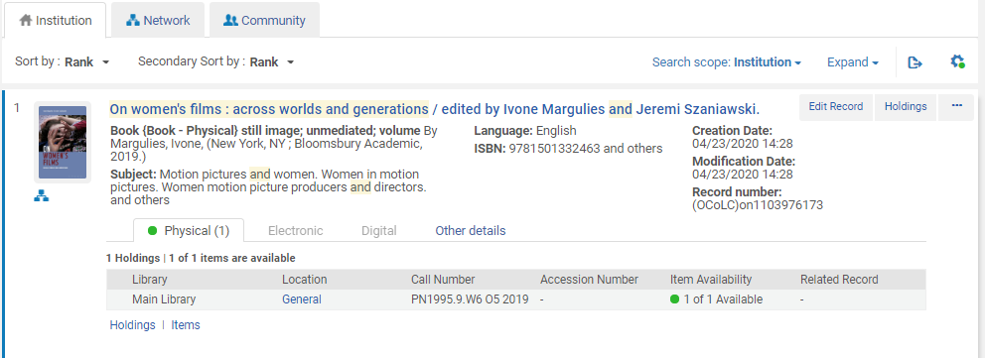
What happens in Alma and Primo when nothing is suppressed?
Now we again search Alma University
Now we see that it has inventory and is linked to the network zone.

Slide 11
What happens in Alma and Primo when nothing is suppressed?
Now we will search Network Zone Primo (note that with Primo VE it may take up to 15 minutes until a new record appears in discovery)
https://na02.primo.exlibrisgroup.com/discovery/search?vid=EXLDEMO2_INST:ConsortiaView&lang=en

Slide 12
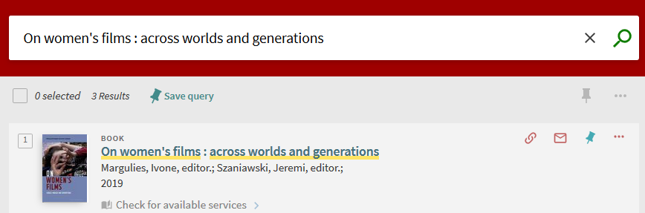
What happens in Alma and Primo when nothing is suppressed?
We search network zone Primo and find the record

Slide 13
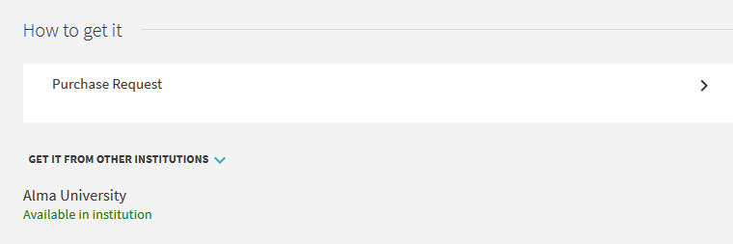
What happens in Alma and Primo when nothing is suppressed?
When searching the network zone Primo the GetIt tab states where it is available
Available at member institution Alma University

Slide 14
What happens in Alma and Primo when nothing is suppressed?
Now we will search member institution Alma University Primo
https://na02.primo.exlibrisgroup.com/discovery/search?vid=EXLDEV1_INST:Alma&lang=en

Slide 15
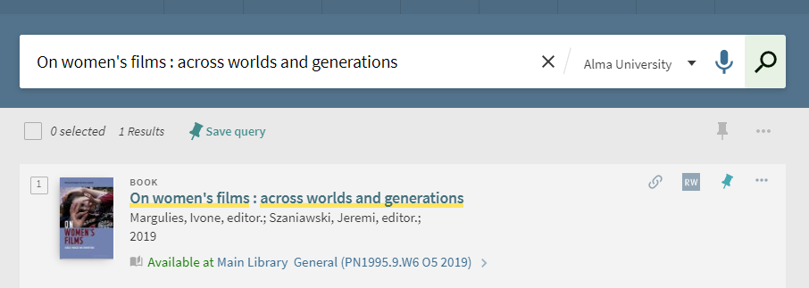
What happens in Alma and Primo when nothing is suppressed?
When searching member institution Alma University Primo We find the record

Slide 16
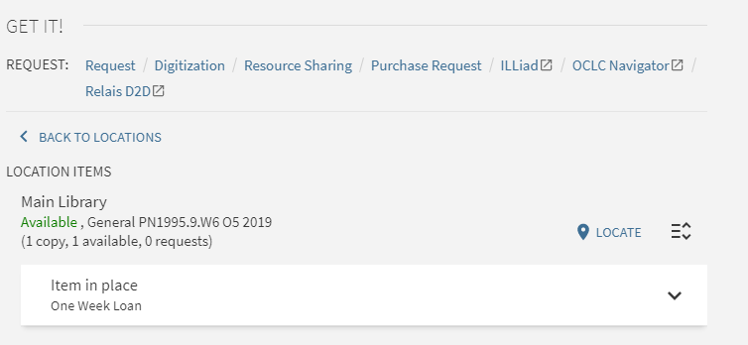
What happens in Alma and Primo when nothing is suppressed?
In member Alma University Primo the GetIt tab states where it is available

Slide 17
What happens in Alma and Primo after we suppress the record only in the network zone?

Slide 18
What happens in Alma and Primo after we suppress the record only in the network zone?
Now in the network zone we will edit the record we have been using, title “On women's films : across worlds and generations” MMSID 99327611100191, and suppress it from publishing

Slide 19
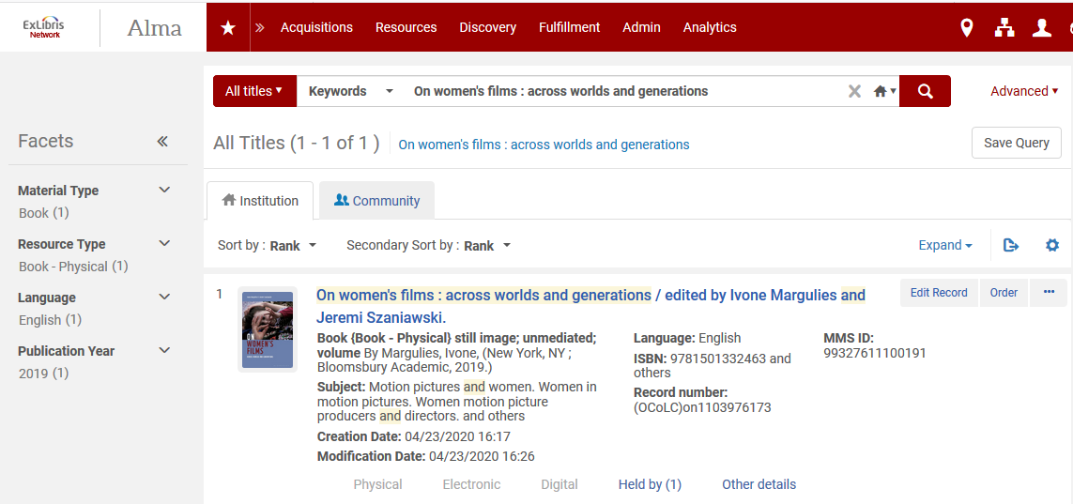
What happens in Alma and Primo after we suppress the record only in the network zone?
In the network zone
Edit the record

Slide 20
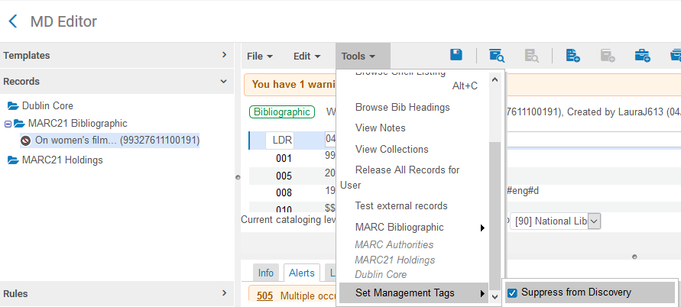
What happens in Alma and Primo after we suppress the record only in the network zone?
The record has been suppressed
The record has been suppressed

Slide 21

What happens in Alma and Primo after we suppress the record only in the network zone?
The record is suppressed in the network zone

Slide 22
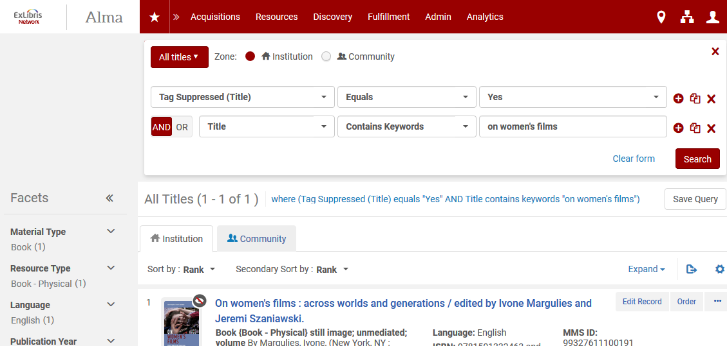
What happens in Alma and Primo after we suppress the record only in the network zone?
More proof that the record is suppressed in the network zone

Slide 23
What happens in Alma and Primo after we suppress the record only in the network zone?
Now we will search Network Zone Primo
https://na02.primo.exlibrisgroup.com/discovery/search?vid=EXLDEMO2_INST:ConsortiaView&lang=en

Slide 24
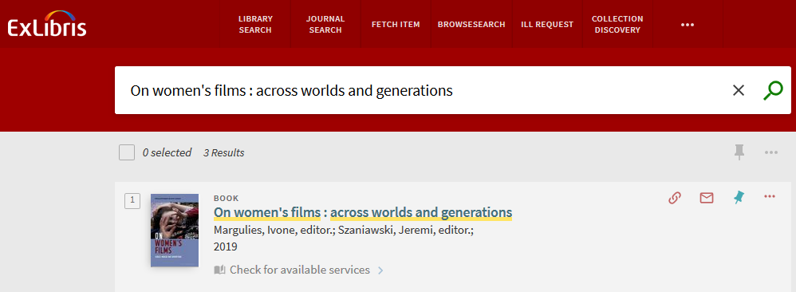
What happens in Alma and Primo after we suppress the record only in the network zone?
The record appears (is not suppressed) in Network Zone Primo

Slide 25
What happens in Alma and Primo after we suppress the record only in the network zone?
Now we will search member institution Alma University Primo
https://na02.primo.exlibrisgroup.com/discovery/search?vid=EXLDEV1_INST:Alma&lang=en

Slide 26
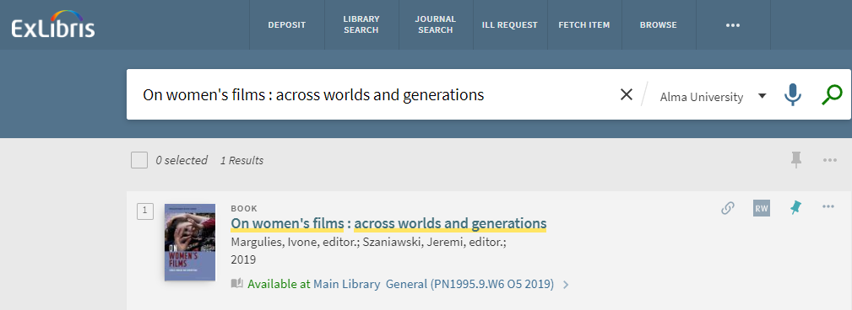
What happens in Alma and Primo after we suppress the record only in the network zone?
The record appears (is not suppressed) in member institution Primo

Slide 27
What happens in Alma and Primo after we suppress the record in the member institution and network zone?

Slide 28
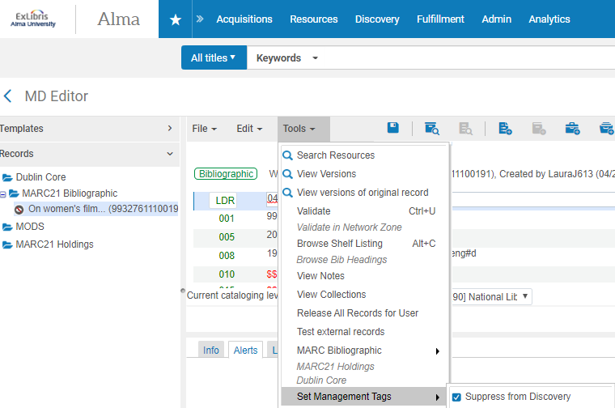
What happens in Alma and Primo after we suppress the record in the member institution and network zone?
Now we suppressed the record also in member

Slide 29
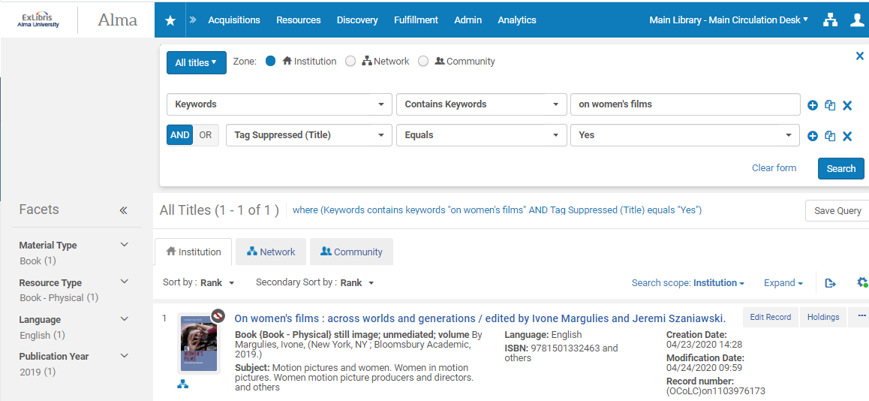
What happens in Alma and Primo after we suppress the record in the member institution and network zone?
Now we suppressed the record also in member
Proper indication that it is suppressed

Slide 30
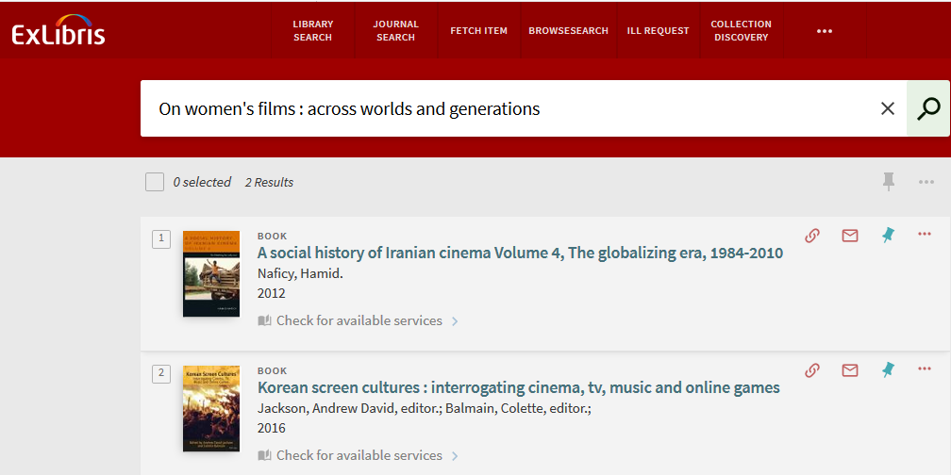
What happens in Alma and Primo after we suppress the record in the member institution and network zone?
The record is suppressed from Network Zone Primo
These are different results than what we searched for

Slide 31
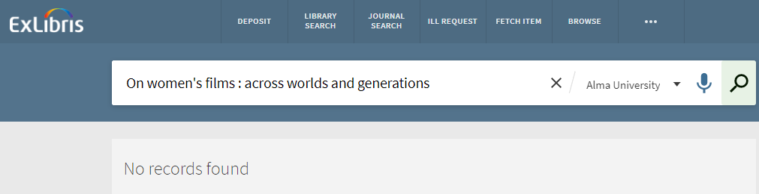
What happens in Alma and Primo after we suppress the record in the member institution and network zone?
The record is suppressed from member institution Primo

Slide 32
What happens in Alma and Primo after we suppress the record only in the member institution?

Slide 33
What happens in Alma and Primo after we suppress the record only in the member institution?
Now we will look at title “Body image: social influences, ethnic differences and impact on self-esteem” which is MMSID 99327611000191 in the network zone.
It is not suppressed in the network zone.
It is suppressed in the member institution.

Slide 34
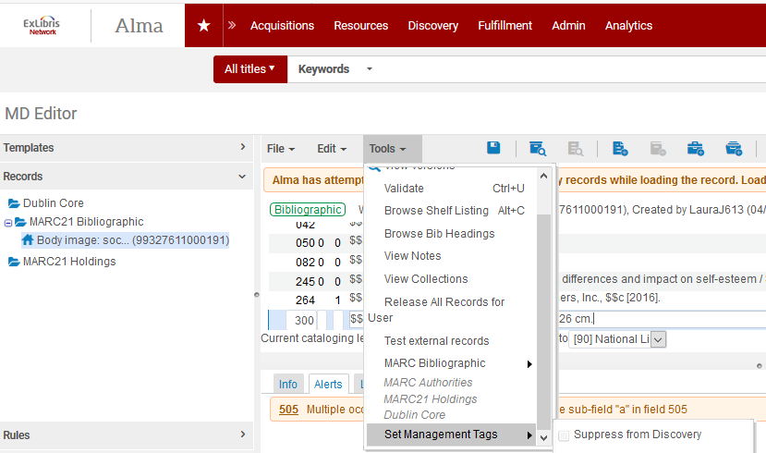
What happens in Alma and Primo after we suppress the record only in the member institution?
Not suppressed in the Network Zone

Slide 35
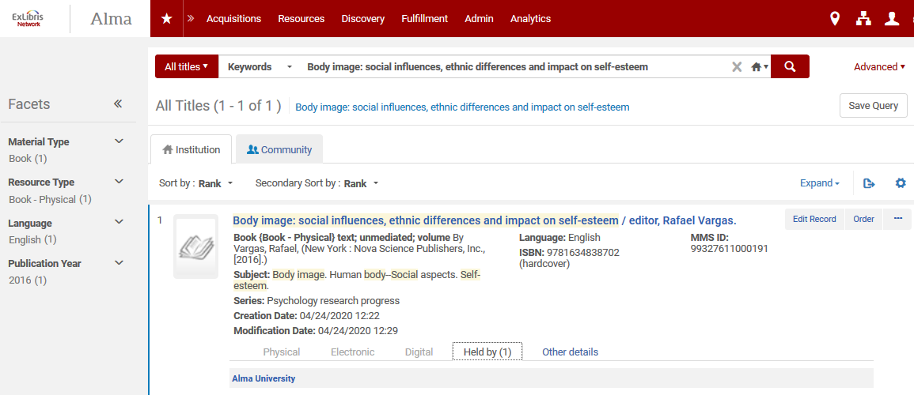
What happens in Alma and Primo after we suppress the record only in the member institution?
Not suppressed in the Network Zone and “Held By” a member

Slide 36
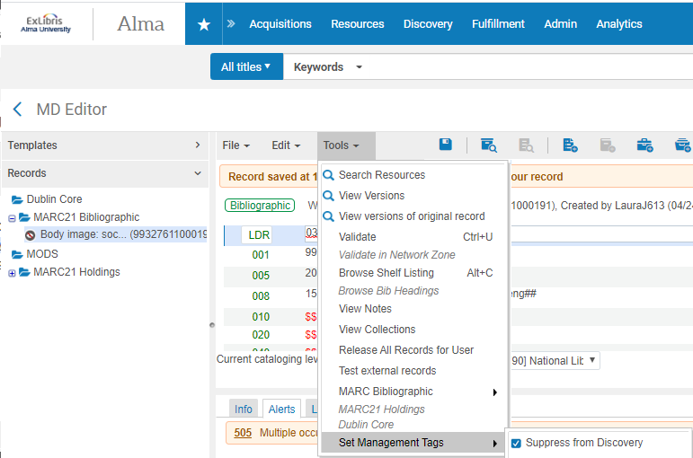
What happens in Alma and Primo after we suppress the record only in the member institution?
It is suppressed in the member institution

Slide 37
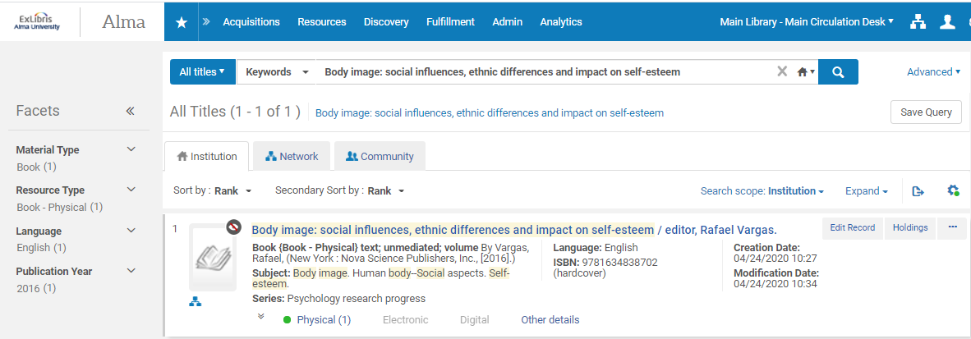
What happens in Alma and Primo after we suppress the record only in the member institution?
We see that it is suppressed in the member institution and linked to network

Slide 38
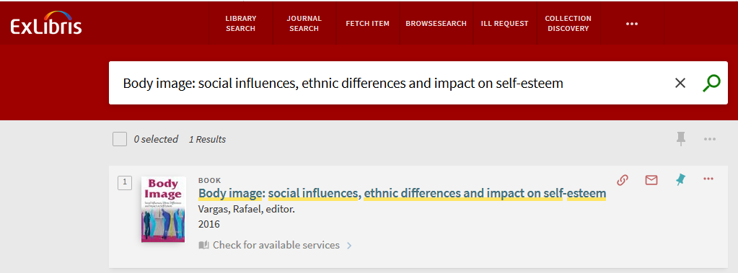
What happens in Alma and Primo after we suppress the record only in the member institution?
In the network zone Primo the record appears (is not suppressed)

Slide 39
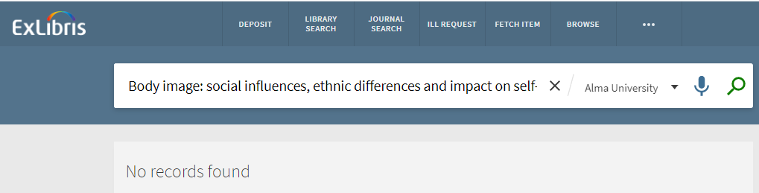
What happens in Alma and Primo after we suppress the record only in the member institution?
In the member institution Primo the record does not appear (is suppressed)

Slide 40
Conclusions

Slide 41
Conclusions
First in table format, then a textual explanation
When a record is in network zone and member institution has record linked to network (as in our example):
Where Suppressed? | Appears in Primo Network view? | Appears in primo Member view
Network Zone only | Yes | Yes
Network Zone and Member Institution | No | No
Member Institution only | Yes | No

Slide 42
Conclusions
If a record is suppressed in the network zone and not in the member institution then
When searching Primo network zone the record appears (is not suppressed)
When searching Primo member institution the record appears (is not suppressed)
This is logical. A user searched the network zone and one of the institutions has the record non-suppressed so it is correct that it is found in the network zone.

Slide 43
Conclusions
If a record is suppressed in the network zone and in the member institution then
When searching Primo network zone the record does not appear (is suppressed)
When searching Primo member institution the record does not appear (is suppressed)

Slide 44
Conclusions
If a record is suppressed in the member institution and not in the network zone then
When searching Primo network zone the record does appear (is not suppressed)
When searching Primo member institution the record does not appear (is suppressed)

Slide 45
Thank you!
xxx@exlibrisgroup.com

